Slide 1


The National Academy of Sciences of Ukraine National Science Center "Kharkov Institute of Physics and Technology" "Nuclear Fuel Cycle" Science and Technology Establishment
DEVELOPMENT OF NEUTRON-ABSORBING MATERIALS AND RCCA WITH INCREASED PERFORMANCE FOR VVER-1000 REACTOR
Volodymyr Krasnorutskyy, Viktor Grytsyna,
Ihor Chernov, Valeriy Zuyok, Anton Kushtym, Volodymyr Zigunov
1st INTERNATIONAL CONFERENCE ON LWR FUEL PERFORMANCE, MODELLING AND EXPERIMENTAL SUPPORT
14-19 September 2025, Sol Nessebar Resort, Nessebar, Bulgaria

Slide 2
RELEVANCE
One of the tasks in launching nuclear fuel production in Ukraine today is to develop and establish national production of rod cluster control assemblies (RCCAs) for the VVER-1000 reactor with improved operational characteristics and technical and economic performance. Recently, this task has become even more relevant as a result of russia's military aggression against Ukraine.
NFC STE NSC KIPT has extensive experience in developing neutron-absorbing materials for application in control rods (CRs) for reactors of various types and purposes. Its activities focus on a wide range of neutron-absorbing materials (HfO₅·Dy₂O₃, Eu₂O₂·TiO₂, Gd₂O₃·ZrO₂, BO₂, Eu₂O₃, GdO₂, DyO₂, B₆Gd, HfB₂, EuB₂, TiB₂) and CR designs to develop rods with the required parameters, reliability, and service life specifically for each type of reactor. Boron carbide and dysprosium titanate have a special position in the list of materials being developed.
Boron carbide and dysprosium titanate, due to their nuclear physics properties, are widely applied as neutron-absorbing materials in thermal neutron reactors. In the CRs of the VVER-1000 reactor, these materials are currently applied in powder form.

Slide 3
1. DEVELOPMENT OF CONTROL RODS FOR VVER-1000
For the development and independence of Ukraine's nuclear energy industry from the supply of VVER reactor components from russia, as the sole vendor, NFC STE NSC KIPT has completed the development of a detailed design of CRs and RCCAs for VVER-1000 reactors. A special work site has been established for the preparation of neutron-absorbing materials, fabrication of CRs and RCCAs. Technical specifications for RCCA have been drawn up and agreed with the State Nuclear Regulatory Inspectorate. A large-scale experimental batch of RCCAs has been fabricated in accordance with the developed technological operations for testing in VVER-1000 reactors, which has been introduced in pilot operation for the second year in one of the Ukrainian VVER-1000 reactors.
Control rod design for VVER-1000

Slide 4
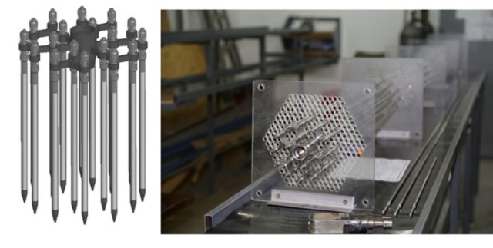
1. DEVELOPMENT OF CONTROL RODS FOR VVER-1000
The fabrication technologies for the developed design of the CRs and RCCAs have been implemented at the enterprises of JSC “NNEGC “Energoatom” during the establishment of their industrial manufacturing in Ukraine.
VVER-1000 RCCA

Slide 5
2. DEVELOPMENT OF PROMISING CONTROL ROD DESIGN FOR REACTORS VVER-1000
When considering tasks related to the development of new materials and designs for neutron absorbers, the starting point is the requirement to achieve higher levels of safety, performance, and cost-effectiveness. Consideration of the possibility to switch from powdered neutron-absorbing materials to pellets reveals the potential to improve the following parameters:
- increase in the content of neutron absorbers in CRs;
ensure uniform distribution of the absorber along the height of CRs;
reducing the impact of the absorber on cladding degradation under operation conditions;
automation of CR fabrication.
The NFC STE has currently carried out comprehensive development work on the fabrication of CRs with neutron-absorbing materials in pellet form as an alternative to standard and developed CR variants, applying boron carbide and dysprosium titanate in powder form.

Slide 6
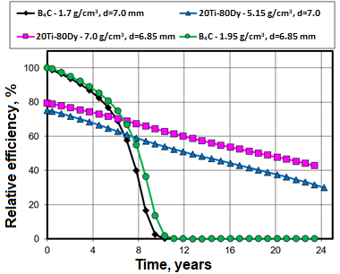
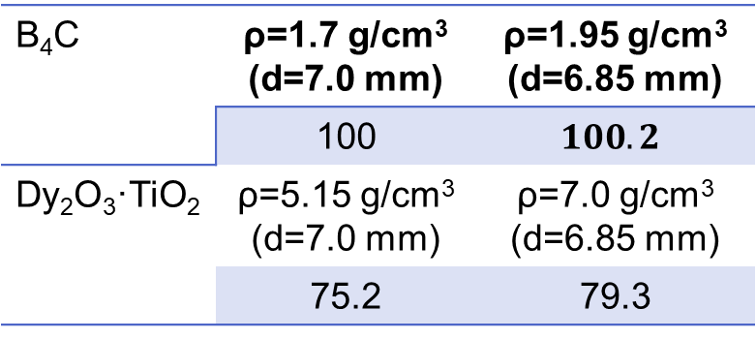
3.4.3 Comparative calculations of the physical efficiency of neutron absorption by CRs
When manufacturing a vibrocompacted version of CRs with B₄C, it is technologically difficult to achieve a filling density above 1.8 g/cm³, and for Dy₂O₃·TiO₂ above 5.15 g/cm³. The switch from the powder to the pellet version of CR enables the regulation of the neutron-absorbing material content within a wider range.
This switch will also increase the technological efficiency of filling CRs through the application of automatic filling devices.
Increasing the density of B₄C from the powder filling density (1.7 g/cm³) to the pellet density (1.95 g/cm³) will increase neutron absorption efficiency by almost 2%, and a decrease in the absorber stack diameter from 7.0 mm to 6.85 mm will reduce the efficiency by almost the same value.
В₄С | ρ=1.7 g/cm³ (d=7.0 mm) | ρ=1.95 g/cm³ (d=6.85 mm)
 | 100 | $$100.2$$
Dy₂O₃·TiO₂ | ρ=5.15 g/cm³ (d=7.0 mm) | ρ=7.0 g/cm³ (d=6.85 mm)
 | 75.2 | 79.3
Change in the relative neutron absorption efficiency of standard absorber materials under operation in VVER-1000 core

Slide 7
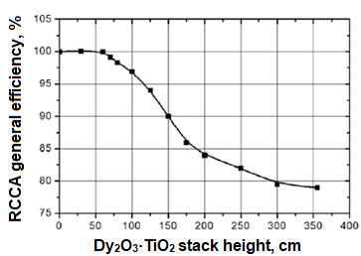
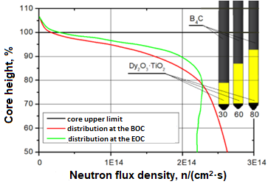
3.4.4 Comparative calculations of the physical efficiency of neutron absorption by CRs
The application of developed neutron-absorbing materials, namely Dy₂O₃·TiO₂ with a density of 7.0 g/cm³ and В₄С with a density of 1.95 g/cm³, in the pellet version of the CR filling (6.85 mm) increases the height of the lower, most loaded part of the CR from 30 cm to 60 cm without reducing the overall efficiency of all RCCAs. The integral efficiency in the scram mode will not change, which is sufficient to ensure the neutronic criteria for CRs performance.
Increasing the height of the Dy₂O₃·TiO₂ absorber stack enables the removal of the B₄C absorber, which exhibits a high burnup rate of the ¹⁰B isotope and low radiation resistance, from the dense neutron (n, α) flux area.
An increase in height to 60 cm results in a 1.27-fold decrease in neutron flux density, and to 80 cm in a 1.64-fold decrease compared to the neutron flux density at the bottom of the B₄C absorbing stack of the standard CR (30 cm) at 70% immersion of RCCAs.
This enables to extend the service life of RCCAs compared to the service life of the standard RCCAs with a Dy₂O₃·TiO₂ stack height of 30 cm.
Change in the integral efficiency of all RCCAs depending on the height of the Dy₂O₃·TiO₂ absorber stack
Axial distribution of neutron flux density along the core height and schematic position of CRs with different Dy₂O₃·TiO₂ stack heights at 70% immersion of CRs from the core bottom

Slide 8
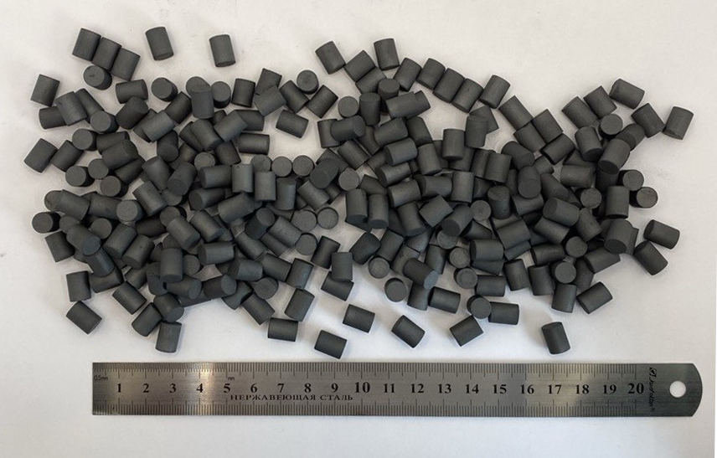
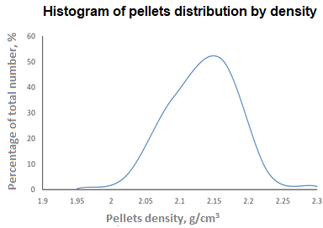
3.1 Technology for producing boron carbide pellets by cold pressing and sintering
Mixing of powders and plasticizer
Pressing of Ø7.6 mm pellets
Vacuum sintering of pellets
Polishing of pellets
Final inspection of boron carbide pellets, certification, and packaging
Incoming control of B₄C powder
(grain size F220 or F240)
Drying of the mixture
Plasticizer annealing
A comprehensive analysis of the research results enabled the selection of parameters for the technological processes of producing B4C pellets, at which a density of ≥ 1.95 g/cm3 was achieved. This enables an increase in the performance characteristics of the RCCAs.

Slide 9
3. DEVELOPMENT AND MATERIAL SCIENCE RESEARCH OF PELLETS
3.1 Requirements for B₄C pellets
# | Parameter | Value
1 | Geometric dimensions: diameter, mm height, mm | (6.85-6.95)* (8.0-11.0)*
2 | Density, g/см³ | ≥1,9*
3 | Types and sizes of acceptable defects in appearance | Spalling on the end surface of pellets (chamfers) should not exceed 10% of the end surface area. The depth of individual spalling should not exceed 1.0 mm. Spalling on the cylindrical surface of pellets shall not exceed 5% of the cylindrical surface area. The depth of an individual spall should not exceed 1.0 mm. Cracks. Individual cracks should not exceed 90° around the circumference of the cylindrical surface.
4 | Phase composition | boron carbide, rhombohedral lattice
5 | Enrichment by isotope ¹⁰B, wt% | 19.9±0.3
6 | Content of B_{total}+C_{total}, wt% | ≥98
7 | Content of В_{total}, wt% | ≥68±1** (73…81)
8 | Impurities
 | Fe |  | ≤1.0
 | Ca |  | ≤0.3
* will be obtained based on the results of technological developments, taking into account the values obtained

Slide 10
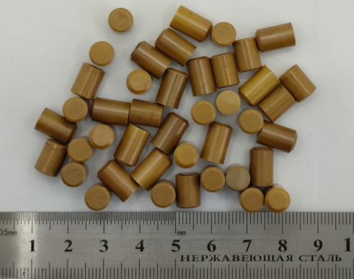
3.1 TECHNOLOGY FOR PRODUCING Dy₂O₃·TiO₂ PELLETS
Mixing of powders and plasticizer
Pressing of Ø8,55 mm pellets
Sintering of pellets at 1650 °C in air atmosphere
Polishing of pellets
Final inspection of dysprosium titanate pellets, certification, and packaging
Incoming control of TiO₂, Dy₂O₃ and МоО₃ powders
Drying of the mixture
Plasticizer annealing
The requirements for dysprosium titanate pellets, technological methods of synthesis, and characteristics of the produced dysprosium titanate pellets were developed.
The effect of pellet production schemes and parameters, the presence and dopants content on the phase composition of synthesized dysprosium titanate and the characteristics of pellets for the VVER-1000 reactor control rods has been studied.
It has been observed that the application of nanoscale TiO₂ powder in combination with MoO₃ results in an increase in the density of sintered dysprosium titanate pellets to 7.0–7.1 g/cm³ and the formation of a single-phase pyrochlore-type structure.

Slide 11
3.1 DEVELOPMENT AND MATERIAL SCIENCE RESEARCH OF Dy₂O₃·TiO₂ PELLETS
Requirements for pellets
# | Parameter | Value
1 | Geometric dimensions: diameter, mm height, mm | (6.85-6.95)* (8.0-11.0)*
2 | Density, g/cm³ | (6.6-7.2)*
3 | Types and sizes of acceptable defects in appearance | - Spalling on the end surface of pellets (chamfers) should not exceed 10% of the end surface area. The depth of individual spalling should not exceed 1.0 mm. - Spalling on the cylindrical surface of pellets shall not exceed 5% of the cylindrical surface area. The depth of an individual spall should not exceed 1.0 mm. - Cracks. Individual cracks should not exceed 90° around the circumference of the cylindrical surface.
4 | Weight percentage of dysprosium, % | 68…72
5 | Weight percentage of titanium, % | 9…13
6 | Structural-phase condition | The base is Dy₂TiO₅ with a fluorite or pyrochlore structure. The presence of other modifications of dysprosium titanate (rhombic, hexagonal) is acceptable. Starting oxides are not acceptable.
7 | Weight fraction of samarium (Sm), europium (Eu), and gadolinium (Gd) impurities not exceeding, % Weight fraction of europium (Eu) not exceeding, % | 0.1 0.01
8 | Dopants. The molybdenum (Mo) content is acceptable not exceeding, % | 3

Slide 12
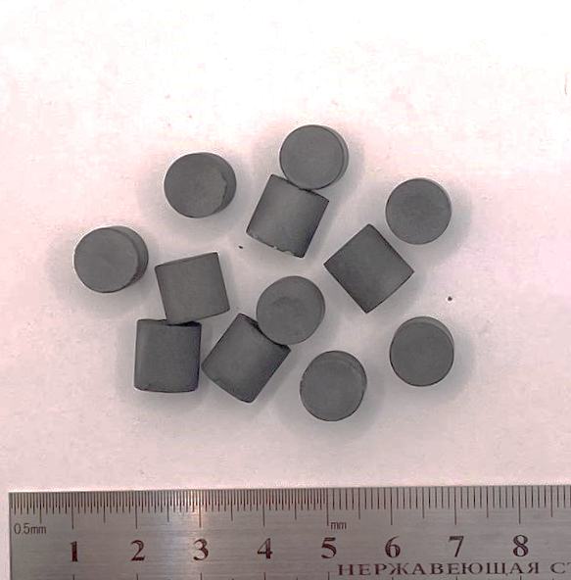
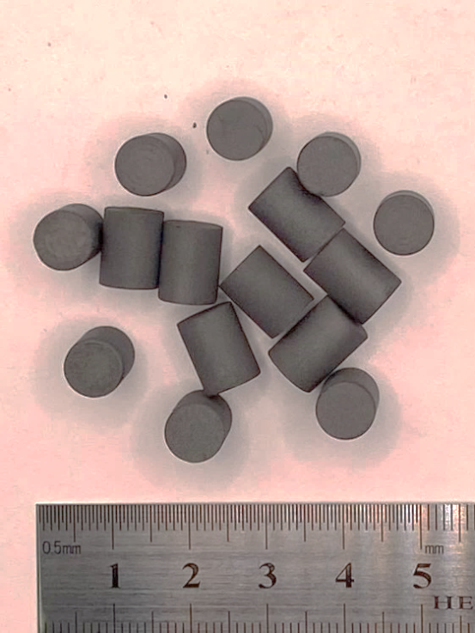
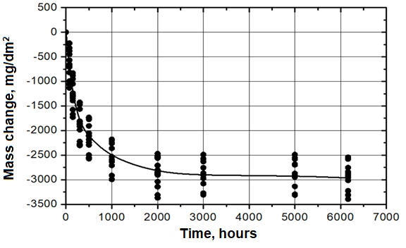
3.2 TESTING AND STUDYING OF PELLETS
initial condition
condition after 6000 hours of autoclaving
Corrosion resistance of В₄С pellets
Corrosion testing of pellets was performed in an open form in static autoclaves made of Cr18Ni10Ti stainless steel, in an aqueous solution of VVER-1000 primary coolant
H₃BO₃ = 3 g/dm³, NH₃ = 3 mg/dm³, KOH = 12.3 mg/dm³, pH = 7.2
at a temperature of 350 °C and a pressure of 16.5 MPa.
The mass corrosion coefficient (mg/dm2) is defined as the ratio of mass gain to unit of area:
– increase/decrease in sample mass, mg;
S – lateral surface area of a pellet, cm².

Slide 13
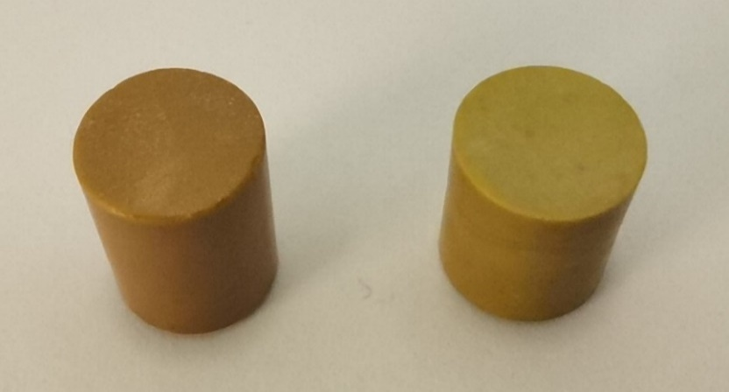
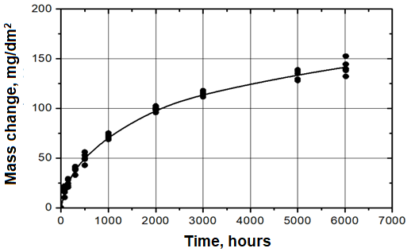
Corrosion resistance of Dy₂O₃·TiO₂ pellets
condition after 6000 hours of autoclaving
Initial condition
Corrosion testing of pellets was performed in an open form in static autoclaves made of Cr18Ni10Ti stainless steel, in an aqueous solution of VVER-1000 primary coolant
H₃BO₃ = 3 g/dm³, NH₃ = 3 mg/dm³, KOH = 12.3 mg/dm³, pH = 7.2
at a temperature of 350 °C and a pressure of 16.5 MPa.
The mass corrosion coefficient (mg/dm2) is defined as the ratio of mass gain to unit of area:
– increase/decrease in sample mass, mg;
S – lateral surface area of a pellet, cm².

Slide 14
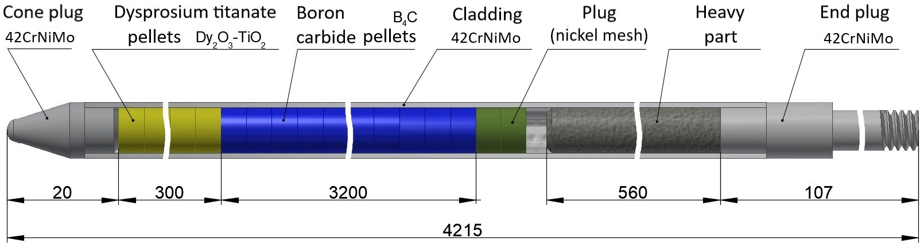
3.3 JUSTIFICATION OF THE DESIGN OPTION FOR THE PELLETED CR OF VVER-1000 RCCA WITH INCREASED SERVICE LIFE
Height of the absorber stack in the developed CR designs
CR design | Height of В₄С, mm | Height of Dy₂O₃·TiO₂, mm
12-1-091 | 3500 | 0
12-1-091-01 | 3200 | 300
12-1-091-02 | 3000 | 500
12-1-091-03 | 2700 | 800
The developed CR differs from the standard CR for VVER-1000 reactors in that the absorber is in the form of pellets instead of powder.
This enables increasing the density of the absorber, ensuring uniform or adjustable distribution of the absorber along the height of the CR, avoiding solid contact between the absorber and the cladding, and automating the process of filling CR cladding with neutron absorbers.

Slide 15
Переробляється
3.4 JUSTIFICATION OF THE PERFORMANCE AND RELIABILITY OF THE CR DESIGN
3.4.1 Compatibility of pellet and cladding materials
The compatibility of the absorber with the CR cladding is one of the criteria for the performance and reliability of the RCCA for VVER reactors.
Cladding material | Maximum burnup of ¹⁰В,% | Compatibility at temperatures
 |  | 300-350°С | ~500°С | ~800°С | ~1000°С | ~1200°С
42CrNiMo (EP-630U) | 40±3 | compatible | compatible | start of intensive interaction | complete cladding embrittlement | cladding failure
Compatibility of boron carbide with alloy 42CrNiMo [1], exposure time 3000 hours
the results of studies on the compatibility of alloy 42CrNiMo with B₄C under the parameters and conditions of operation in a reactor at temperatures of 350 °C and 500 °C for 3000 hours revealed that when the pellets came into contact with the cladding at 350 °C, no structural changes were detected in the cladding and no interaction was observed. At a temperature of 500 °C, a weak interaction zone was observed, and noticeable interaction between the 42CrNiMo alloy cladding and boron carbide began at temperatures of 800–1200 °C. This means that under normal operating conditions of CRs in a VVER-1000 reactor, the compatibility of boron carbide pellets with a 42CrNiMo alloy cladding will be ensured throughout their entire service life;
(Dy₂O₃·TiO₂) is compatible with chromium-nickel alloys and austenitic steels (42CrNiMo, 06Cr18Ni10Тi) under operating temperature of 300...350 °С in VVER-1000 reactor during, at least, 20 years, which has been experimentally confirmed under reactor irradiation conditions [2].
[1] Фридман Р. С., Рисованый В. Д. Головченко Ю. М. Термические испытания облученных макетов и фрагментов ПЭЛ с В₄С // Сборник докладов 5-й межотраслевой конференции по реакторному материаловедению. - 1998. -Т 1, ч. 2., Димитровград
[2] Risovany V. D., Varshalova E. E., Suslov D. N. Dysprosium titanate as an absorber material for control rods. Journal of Nuclear Materials. 2000. Vol. 281. P. 84-89

Slide 16
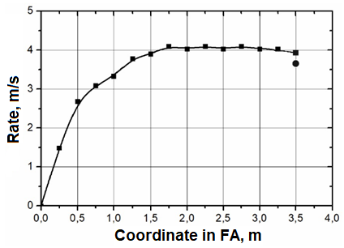
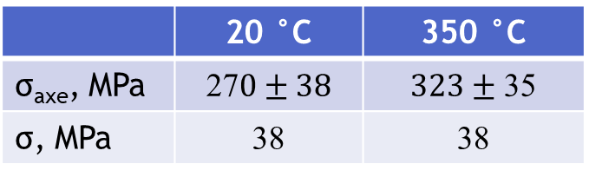
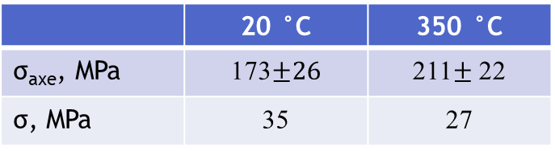
3.4.2 CRs performance under dynamic loads
During reactor operation, standard situations may occur in which the scram mode is activated and RCCAs immerse themselves under their own weight into FA guide thimbles at a maximum speed of up to 4 m/s. Under these dynamic loads, the main impact is on the RCCA top end plug and the FA top nozzle, where the energy is partially damped by springs.
To demonstrate the safety margin of dysprosium titanate and boron carbide pellets, an assessment of dynamic loads on the absorber pellets during collision of the RCCA with the FA top nozzle was performed. The calculation results revealed that the safety margin coefficient is sufficient to maintain pellet integrity. The calculation results are confirmed by experiments on the dropping of the RCCA on a test rig.
Dynamic loads are calculated for the acceleration during striking of RCCA with FA top nozzle of 31g, for the lower pellet (S=36.8 mm²):
CR design | Height of В₄С, mm | Height of Dy₂O₃·TiO₂, mm | Striking force, N | Stress in pellets, MPa | Load factor
12-1-091 | 3500 | 0 | 87 | 2,4 | 79
12-1-091-01 | 3200 | 300 | 104 | 2,9 | 99
12-1-091-02 | 3000 | 500 | 115 | 3,1 | 93
12-1-091-03 | 2700 | 800 | 132 | 3,7 | 78
Механічні характеристики таблеток титанату диспрозію
Механічні характеристики таблеток B₄C
 | 20 °C | 350 °C
σ_{axe}, MPa | 27$0±38$ | $323±$ 35
σ, MPa | 38 | 38
 | 20 °C | 350 °C
σ_{axe}, MPa | 173$±26$ | 211$±$ 22
σ, MPa | 35 | 27

Slide 17
CONCLUSION
In Ukraine, designs and technologies have been developed for manufacturing control rods for VVER-1000 reactors applying neutron-absorbing materials such as boron carbide and dysprosium titanate in powder and pellet versions.
In fact, these methods for fabrication of control rods can be applied when applying other types of neutron-absorbers. To date, a set of technological operations has been developed for the production of materials with the required characteristics in powder and pellet versions with boron carbide and dysprosium titanate. A comprehensive out-of-pile tests and research have been carried out to justify the performance of control rod materials under the parameters and operating conditions of VVER-1000 reactors.
The developed designs of control rods and technologies for fabrication of RCCAs as an alternative to the standard design have been implemented in industrial production.
In 2024, a batch of 12 RCCAs was delivered for pilot operation in the VVER-1000 reactor at the Rivne NPP. Based on the results of the RCCA inspection after the first year of operation, the SNRIU granted permission for their further operation.

Slide 18
CONCLUSION continue
The development of control rods with neutron-absorber in pellet version for VVER-1000 reactors has a number of distinctive features. The application of neutron-absorbers developed within the scope of this work, namely Dy2O3·TiO2 and В4С, in a 42CrNiMo alloy cladding with a pelletized rod filling enables an increase in the height of the lower, most loaded part of the control rod with Dy2O3· TiO2, to 60 cm without reducing the general efficiency of the scram mode compared to the standard CRs, which has an (n, γ) absorber 30 cm high, which significantly increases the service life of the CRs and the RCCAs.
Actually, the issue of introducing pelletized control rods into production and operation should be considered further during the implementation of new VVER-1000 reactor cycles and the possibility of developing control rods for other reactors, such as Generation III+, IV, and SMRs. This particularly refers to the development of control rods with other promising neutron-absorbing materials. NFC STE NSC KIPT specialists are ready to cooperate with interested foreign specialists and organizations to perform joint work in this field.

Slide 19
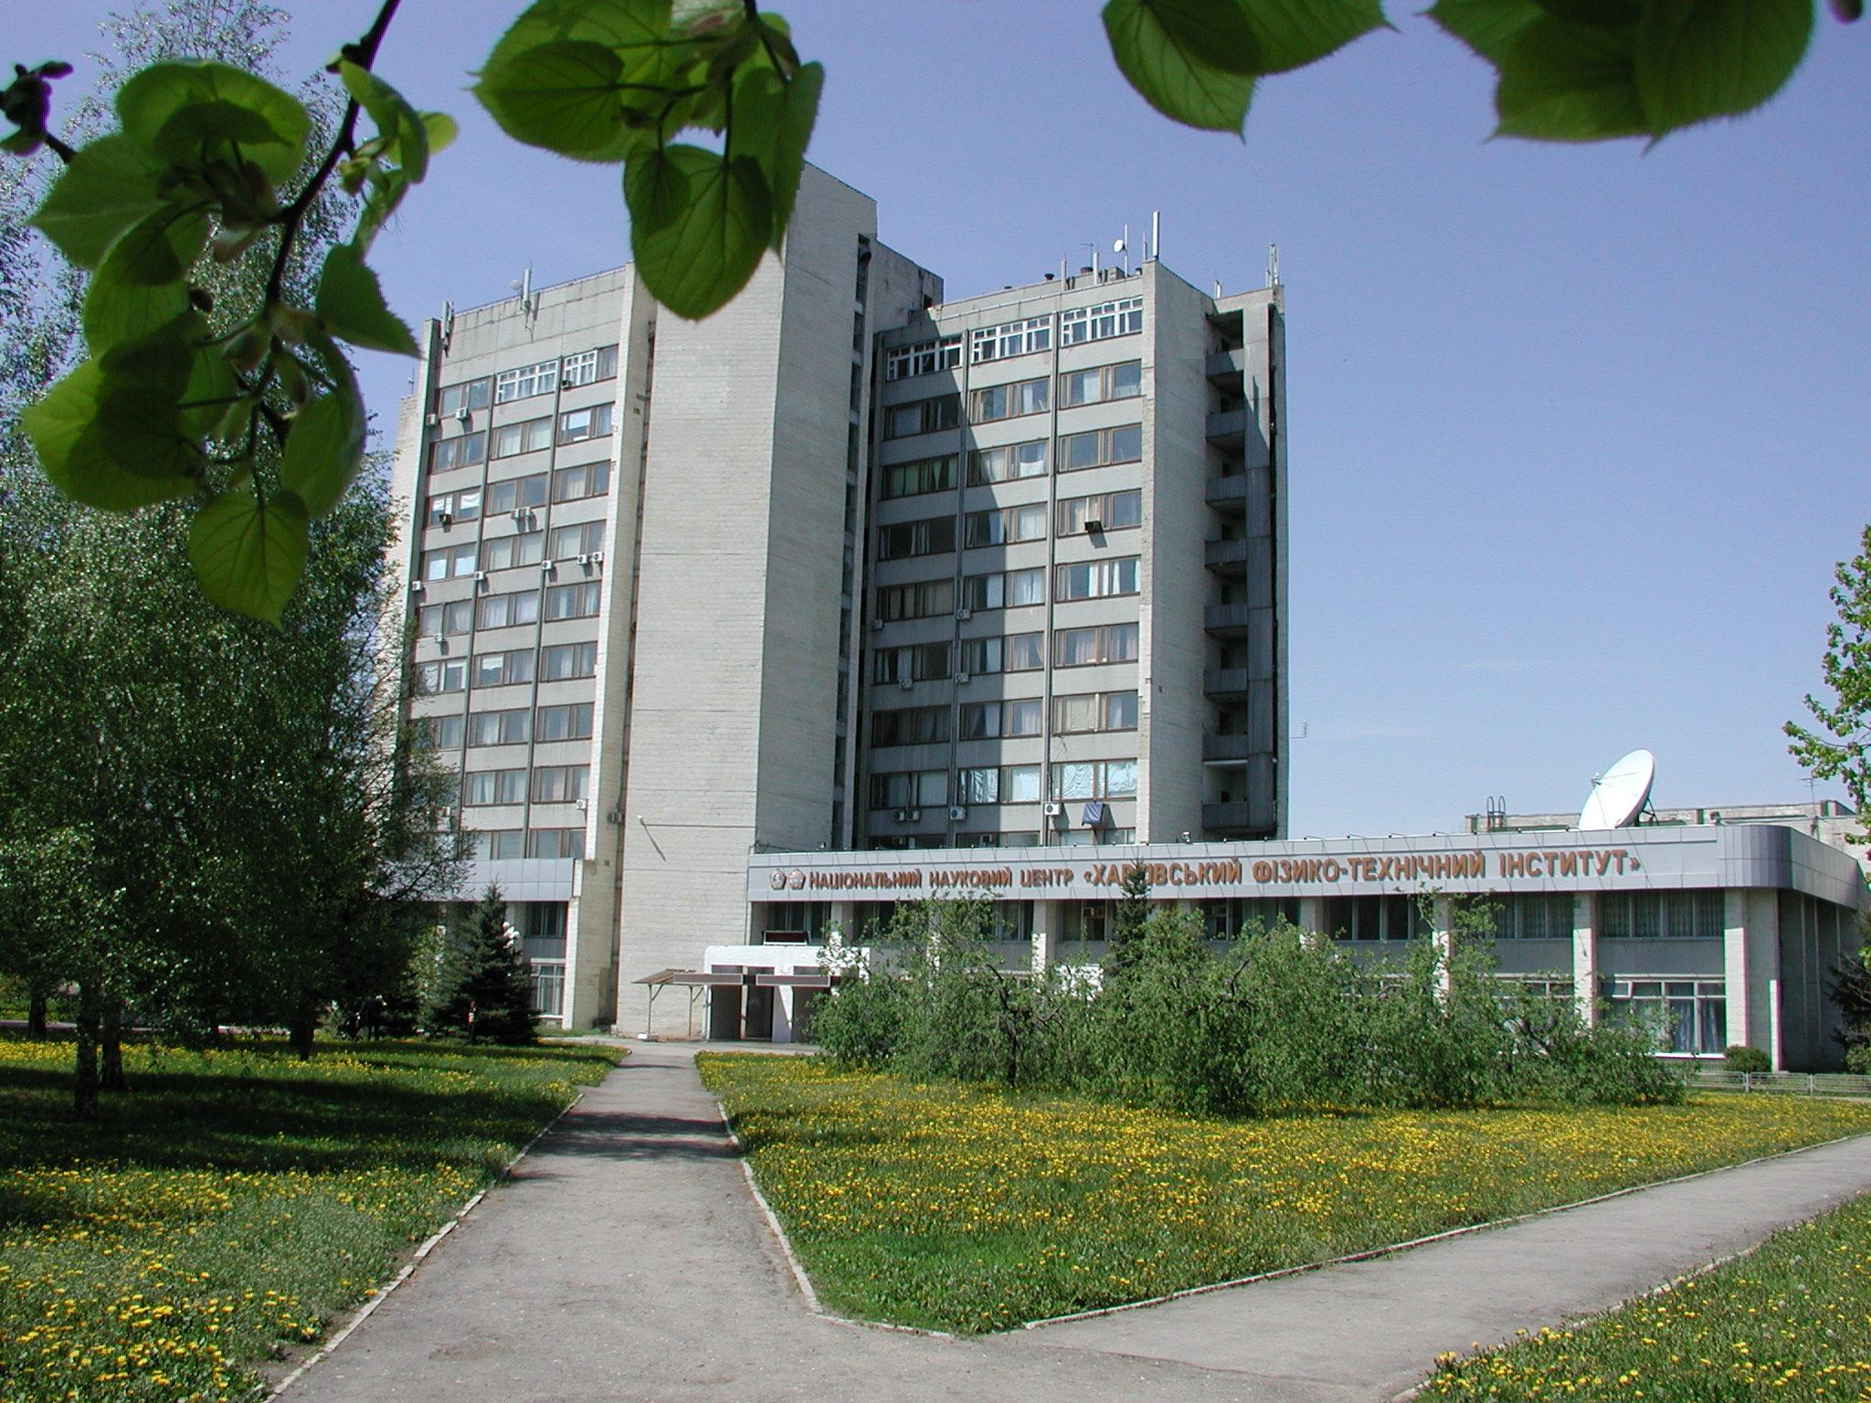
Thank you for attention!

